Slide 1
Tuber Simulator
Coding & functions Guide

Slide 2
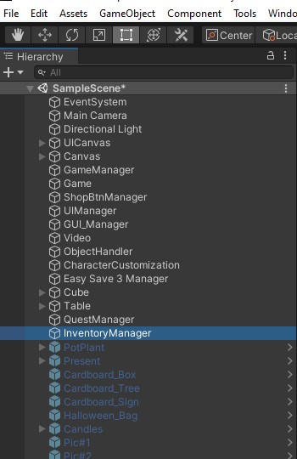
Hierarchy Components and Objects
There are total 18 objects visible. Not every object is important to understand so we will skip through it like “EventSystem, Directional Light, Easy Save3 Manager”
There is one more component other then these named Ads Manager I will let you know about it in the end.

Slide 3
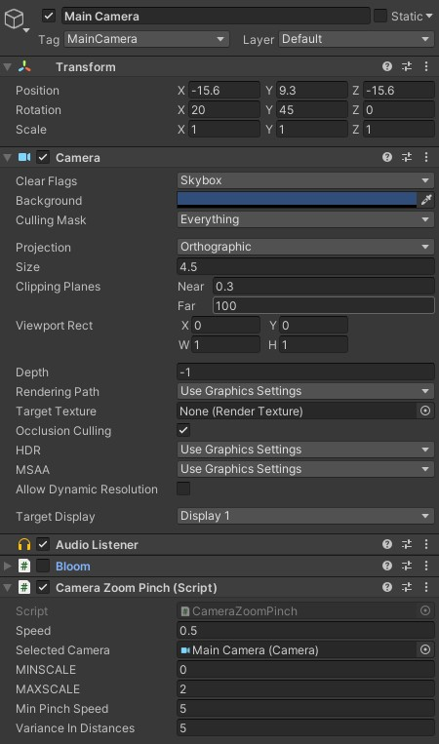
Main Camera
Position is set be very care full about that
Other then that Mode is set in orthographic which help us to feel the isometric view.
Size is 4.5 but user can change it by pinch touch control
Camera Zoom pinch holds the camera scale and movement you can play around it.
Bloom is a custom scripted visual you can turn it on it will make things a little bit brighter you can also set values so it act accordingly.

Slide 4
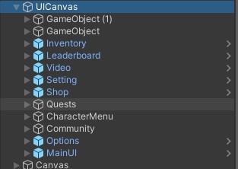
UI_Canvas
These all are the menus use in the game Like:
Video Making
Shop
Quest and stuff and etc
These all menus stay always live and when user close a menu it just slide it to left side which makes the game way more smooth since we don’t need to make it live and off again and again.

Slide 5

Camera Size Canvas
This canvas hold the background image and Character Edit Menu.
Background Is background and sparkles with it
Character menu has Character Things like button images Agree Close buttons.

Slide 6
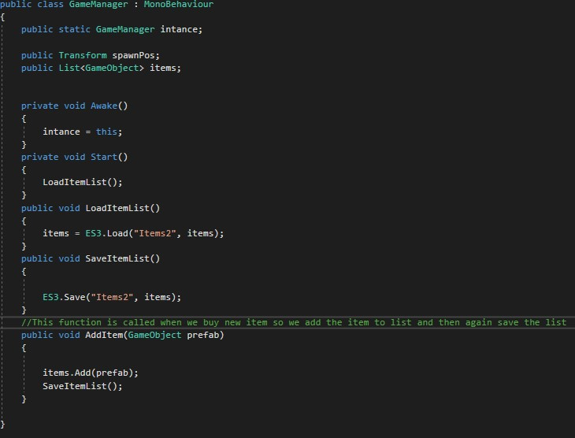
Game Manager
I haven’t Putted a lot of load on this script but its here to make extension and new features like tuts or anything. It will help future developers

Slide 7
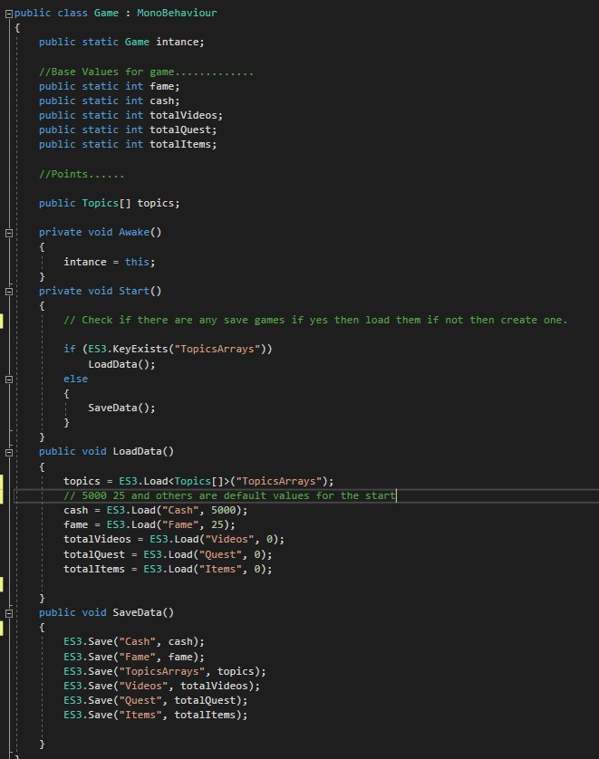
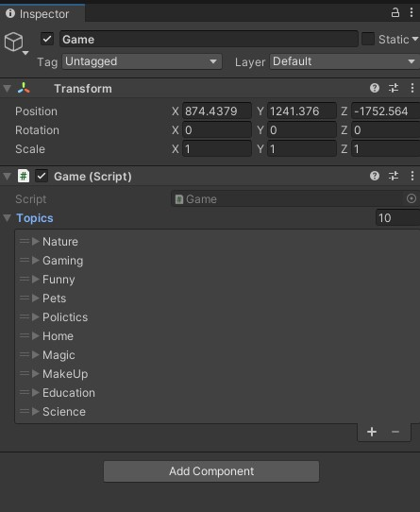
Save Game/ Database
One of the most important script of the game where its all saved “Cash, Fame points, The items which will make videos go viral or anything.
This script do the both Saving and Loading.
To add any other viral points this script makes its real easy just add and set the values in inspector that’s all you need (no coding).

Slide 8
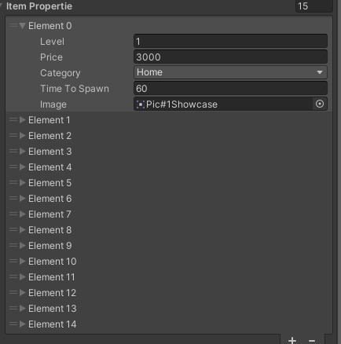
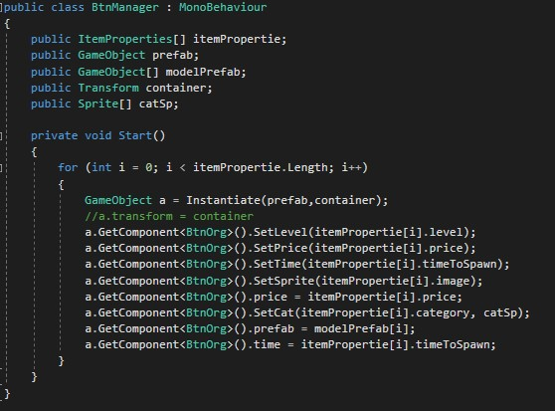
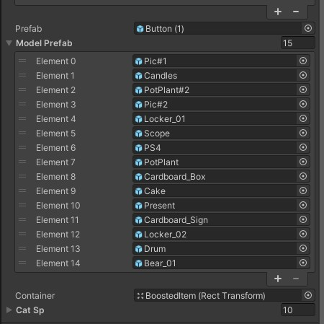
Items in the shop
BtnManager Allow you to create a button in shop with you setting every object
Price, Level, Category, Time it will take to spawn and image of the item
Can add as many object as you want.
Automatic Item Button Creation.
No Coding and no Editor and UI UX.
After adding item button property just add the item in the list below named Model Prefab So it will spawn the object when button is pressed.

Slide 9
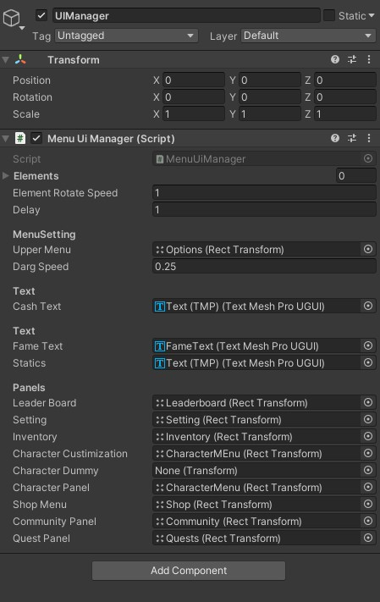
UI_Manager
All panels are in this script you. This script is responsible for almost all the UI actions in the game Like: Opening the panels, Displaying the coin amounts, Buttons response ETC.
The script has many function and do there jobs like there name nothing to Complex.

Slide 10
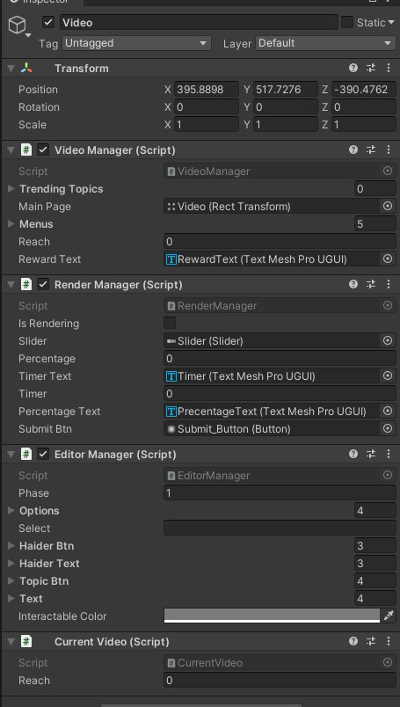
Video Manager
This GameObject hold the whole video creation process
Video Manager Allows you to select the topic, Genre And proceed to rendering part.
Editor manager ask some question randomly with option Which can make your video hit or go fall.
Render manager set the timer on and turn on the Slider, percentage etc to work.

Slide 11
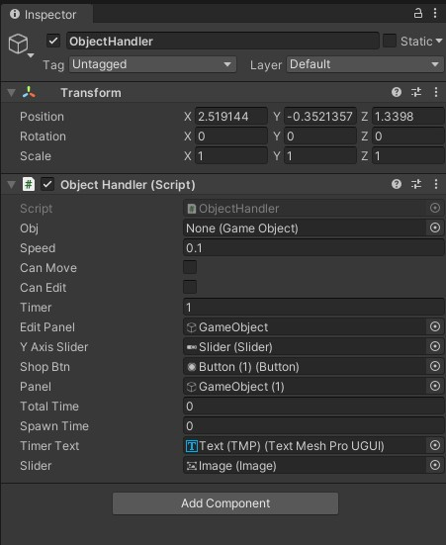
Object Handler
This handle the object when we try to move a object or just bought the object and check the timer. Also this is responsible to send object to inventory.

Slide 12
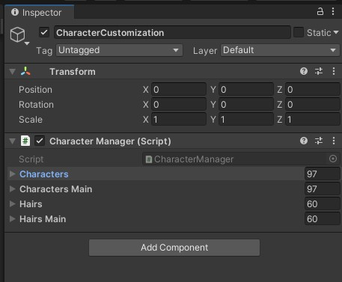
Character Customization
This script make its super easy to add and remove new character clothes and attachments.
There are 2 columns for hairs and characters one is for main character and one is for dummy which we can see in the customization panel

Slide 13
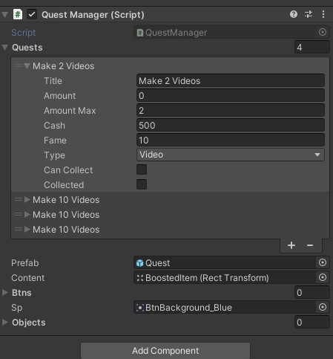
Quest Manager
Add new quest are easy
Just add more quest in array
Define the Title, amount, max amount where it should be collectable, Cash or fame the player will be rewarded after he complete the quest, Type of the quest (make video, Buy item , Get as many followers) Other two will be defined by it self.
Two add new quest its important run the command to delete the quest key and add a new one.

Slide 14
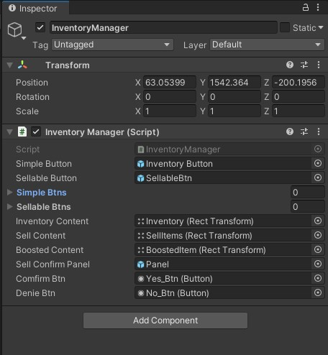
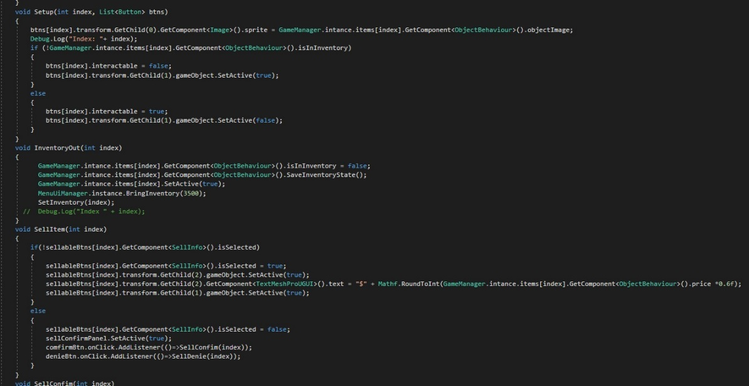
Inventory Manager
It does all the stuff related to inventory and sellable items
This script also open the three of its panel inventory , sellable panel, boosteditems.
This script also set which object is in inventory and which is not and what will happen you sell an item.
An function do a math and set the rate so if user decide to sell the item he will face a little bit of loss.
After the click There will be buttons to confirm if user really want it or not.

Slide 15

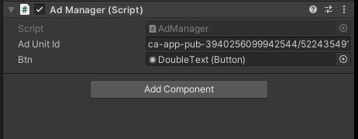
Ad Manager
Last Component is Admanger holding to values
Ad unit Id : which is set to fake id by deflaut and you can set it to your own.
Second is the button which appear after video is made and user can click it to double up the revenue. This button will be disabled if ad is not avaible.
To change the app id(not ad id) go to
Assets > Google Mobile Ads > Setting : Android and ISO both are there.

Slide 16
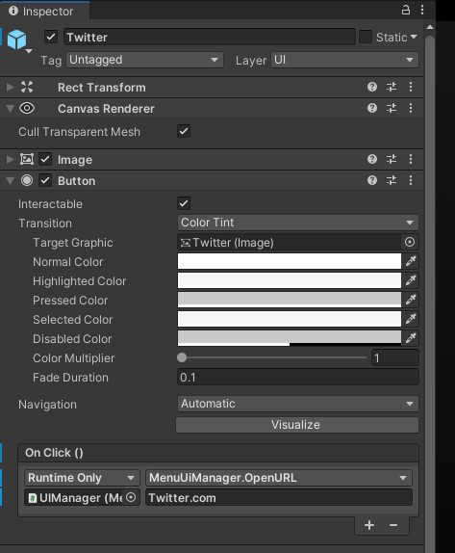
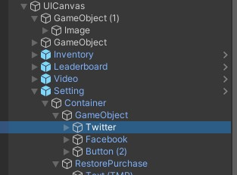
Social Links
To change the links go to
Ui Canvas > Setting > Container > GameObject
Any platform you wanna change > then in inspector change this text shown in image

Slide 17
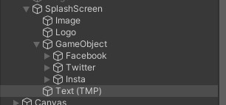
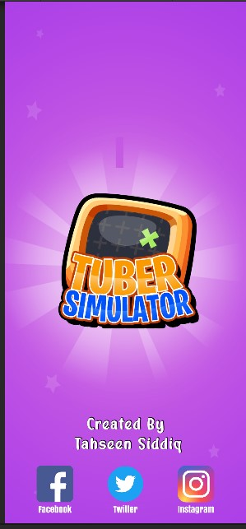
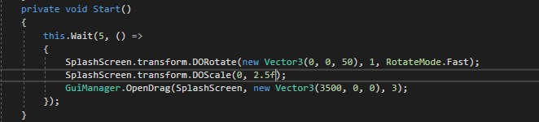
Splash Screen
To change the splash screen setting go to
UIManager > Start()
Logo
TEXT(TMP)

Slide 18
Last Words
Hope You like the final progress
Still you find any bug or issue please do contact
Any bug or issue is on me I will get back to you as soon as possible.
If you have any developer for future work and he need any guide for my code I will be up for him.
Thank you very much for choosing me for your work and hope we will work in future .
Have a very good day.

